Slide 1
Lecture No. 26 Fuels
At the end of this lecture, students will be able to:
Describe the function of catalytic converters
Explain the importance and sources of biodiesel and power alcohol
Discuss the preparation of biodiesel and power alcohol

Slide 2
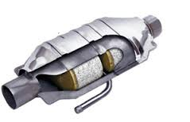
Catalytic Converter
Brief History:
Catalytic converters were first widely introduced in American production cars in 1975 due to EPA regulations on toxic emissions reductions
The United States Clean Air Act required a 75% decrease in emissions in all new model vehicles after 1975, a decrease to be carried out with the use of catalytic converters
Definition:
Device used to reduce the emissions from an internal combustion engine (used in most modern day automobiles and vehicles)

Slide 3
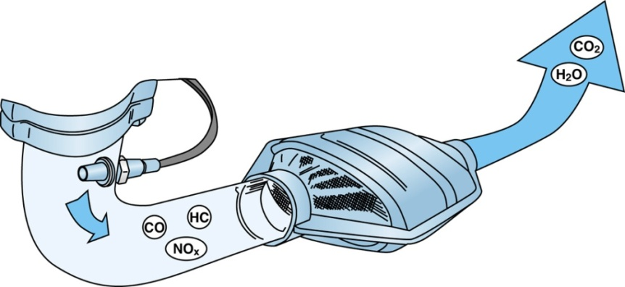
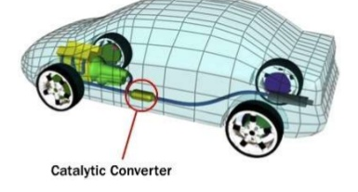
Catalytic Converter
Catalytic converters are used in exhaust systems to provide a site for the oxidation and reduction of toxic by-products (like nitrogen oxides, carbon monoxide, and hydrocarbons) of fuel into less hazardous substances such as carbon dioxide, water vapor, and nitrogen gas

Slide 4
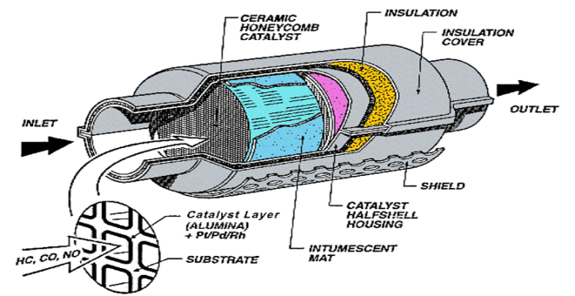
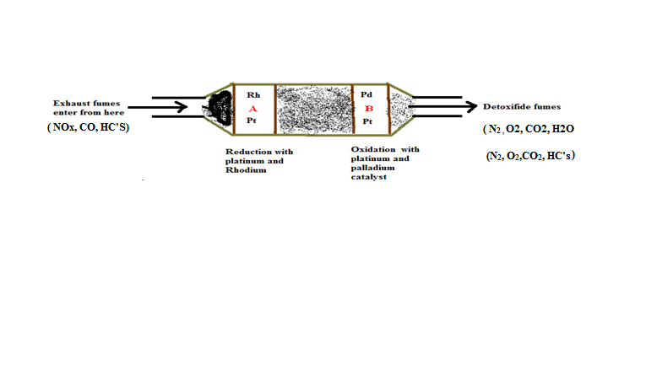
Catalytic Converter
Two main types of catalytic converters
honeycomb and ceramic beads
Components of catalytic converter:

Slide 5
Catalytic Converter
Reactions in Catalytic converter
Reduction of nitrogen oxides to nitrogen and oxygen
2NOx Rh + Pt xO₂ + N₂
Oxidation of carbon monoxide to carbon dioxide
xCO + O₂ Rh + Pt xCO₂
Oxidation of unburnt hydrocarbon to carbon dioxide and water
xCxHy + O₂ Rh + Pt xCO₂ + xH₂ O

Slide 6
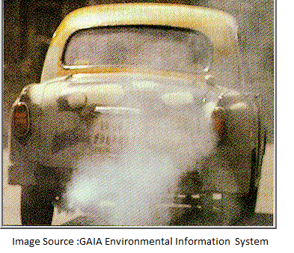
Catalytic Converter
Causes of Catalytic Converter Failure
Catalytic converters are made of fragile ceramic, thereby rendering it delicate
A malfunctioning converter will negatively affect the whole exhaust system
Leaking oil causes air pathways to become blocked

Slide 7
Catalytic Converter
Limitations of Catalytic Converter:
Temperature up to 1000 ^{O}C is required
Metal in the catalyst is prone to deactivation by sintering
Functionless beyond 80,000km
Unburned fuel
Damage from road fragments

Slide 8
Catalytic Converter
Symptoms of a Defective Catalytic Converter
Increase in fuel consumption of the vehicle
Low response from engine when one accelerates
Oxygen sensor alert
Rattling noise due to soot deposition on the walls
Going off of the engine without a reason
Ways of Extending the Life of a Catalytic Converter
Frequent maintenance of vehicle
Re-installation of the catalyst in the converter after certain kilometers of usage of vehicle (generally a palladium catalyst has to replaced after 80000kms)
Use unleaded fuel

Slide 9
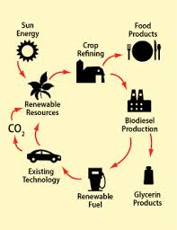
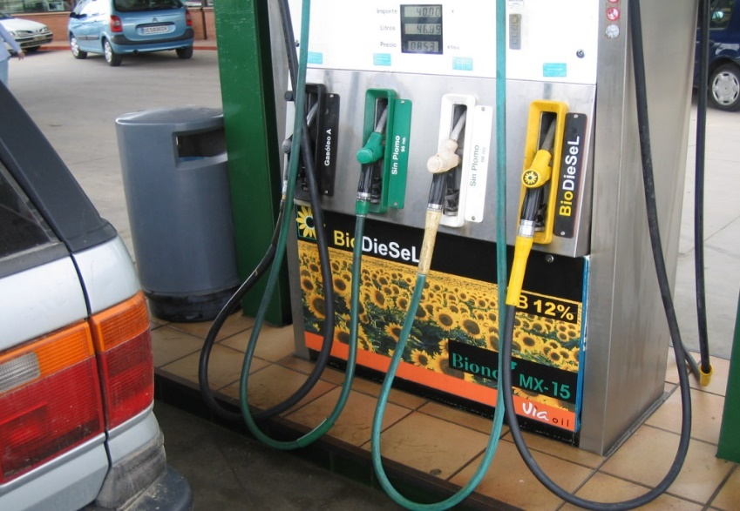
Biodiesel
Biodiesel is a general name for methyl esters from organic feedstock
Biodiesel can be made from a wide range of vegetable oils:
- Jatropa plant extract
- rapeseed – the most common one
- sunflower
- palm oil
- soy
- recycled cooking oils
Germany and France are the largest EU producers

Slide 10
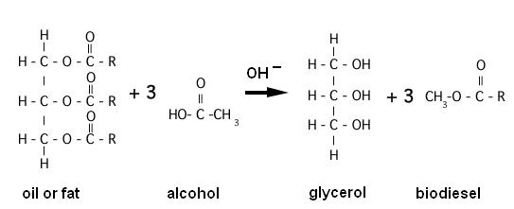
Biodiesel
Vegetable oil and animal fat
Biodiesel is made by converting the oils and fats into “esterified oil” by trans-esterification

Slide 11
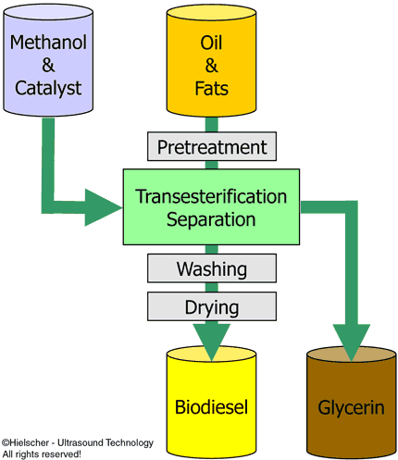
Biodiesel Synthesis

Slide 12
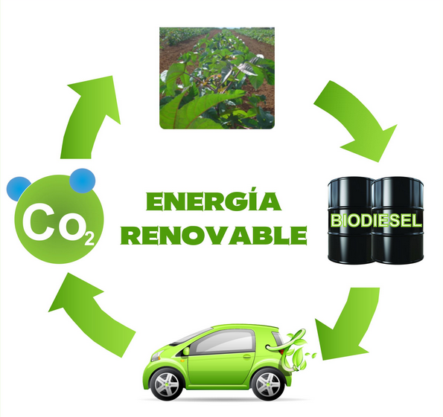
Use of Biodiesel
Biodiesel can be used pure or blended.
Most common blends is 5% biodiesel, 95% diesel
Blends above 5% may invalidate manufacturers warranty
Blends above 30% may require modifications in the engine
rubber seals perishing and injectors blocking

Slide 13

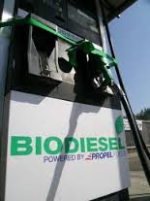
Biodiesel
Advantages:
Biodegradable so less harmful if spilled
Produces lower emissions than diesel
Renewable
Less C_{x}H_{y} , CO and particulates released
NO_{x} is higher but is easier to deal with using catalytic convertors
Disadvantages
Crop needs to be commercialized
Doesn’t address the need to be more energy efficient
Still emissions exist

Slide 14
Biodiesel and the Environment
Use of 100% biodiesel would reduce “life-cycle” CO₂ emissions by 40 to 50%
Use of 5% blend reduces CO₂ emissions by 2 to 2.5%
Eco-friendly

Slide 15

Power Alcohol
Alcohols also have found use as octane enhancers
Power alcohol is the blend of absolute alcohol and petrol
Oxygen present in alcohol aids in complete combustion of the hydrocarbons in petrol there by reducing the peroxide formation and hence knocking is reduced
Source:
Starch – from corns (majorly maize)
Molasses – byproduct of Sugar industry

Slide 16
Advantages of Power Alcohol
Better anti-knock properties
Higher octane number, alcohol-blended petrol can be used in engines with higher compression ratio
No starting difficulty with alcohol-petrol blend
Air required for complete combustion is less
Ethyl alcohol contains oxygen atom, which helps for complete combustion of power alcohol
Reduces CO and volatile organic compound emissions
Economically cheaper

Slide 17
Disadvantages of Power alcohol
Alcohol lowers the calorific value of petrol
Difficulty in starting engine at lower temperature
Ethyl alcohol may undergo oxidation reaction to form acetic acid, which corrodes engine parts
Ethyl alcohol contains oxygen atoms, the amount air required for complete combustion is less and therefore air regulation is required
Blending agents such as benzene or toluene are used

Slide 18
Summary
Function of catalytic converters: Device used to reduce the emissions from an internal combustion engine
Biodiesel: Biodegradable so less harmful if spilled and produces lower emissions than diesel, renewable
Power alcohol: Better anti-knock properties, Higher octane number, alcohol-blended petrol can be used in engines with higher compression ratio

